Slide 1
Understanding PHISHING Attacks
(Social Engineering )
-Hitesh Kantariya

Slide 2
Content…
What is Phishing ?
How it works ?
Types of Phishing
Case study and Tools
Protecting against Phishing
Effects of Phishing
Conclusion

Slide 3
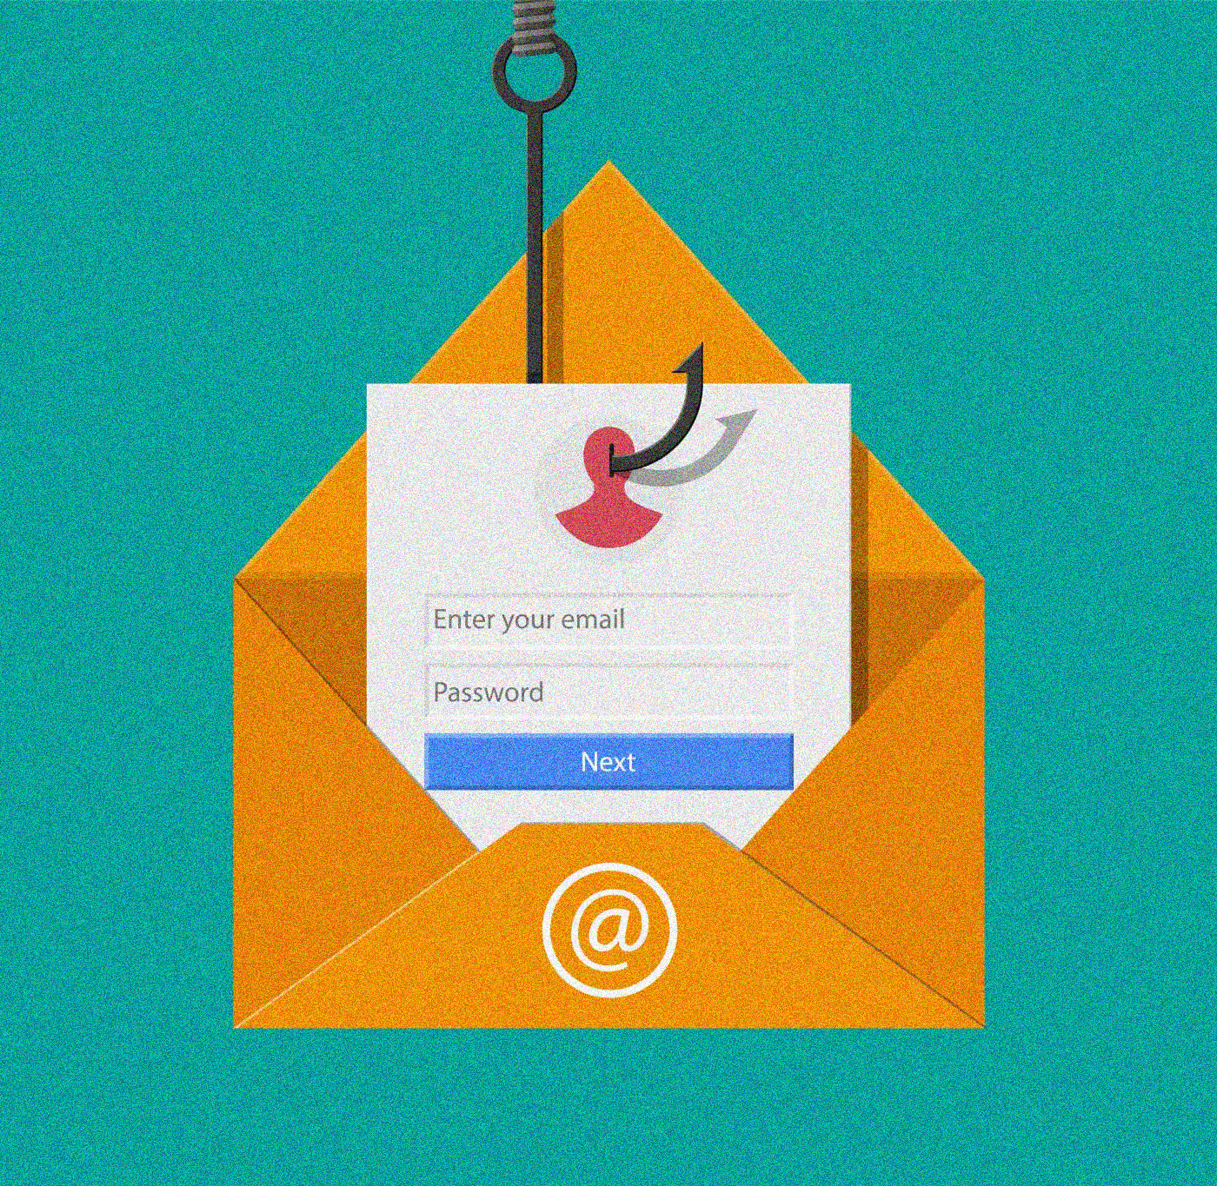
What is Phishing ?
Defination :
“Phishing is type of cyber attack where attacker disguise as a trustworthy entity to target for receiving sensitive Information and credentials.”
The motivation of phishing is to steal information and credential of individual or organisation.
This is the one of the most popular social engineering attack.
Hacker uses different methods to lure him.
Now, we understand the working of this attack…

Slide 4
How it Works ?
It is a method in which the attacker find a victim or target for attack and send a trapping request to the user and collects information.
Method of Phishing :
Deceptive URL’s
Malicious attachment
Social engineering
Link manipulation

Slide 5
Types of Phishing
E-mail phishing
E-mail
Message
Spear phishing
Searching
Convincing
Whaling
High profile Target
E-mail phishing
Spear phishing
Whaling

Slide 6
I ) E-mail phishing :
Most common form.
Fake emails appearing to be from legitimate sources (banks, companies). Requests for sensitive information or clicking on malicious links.
To attract user sending promotion mails which containing malicious folders,links and any other attchments.
II ) Spear phishing :
Targeted attacks on specific individuals or organizations.
Research-based approach using personal information.
Often more convincing and harder to detect.

Slide 7
III ) Whaling :
Targets high-profile individuals like CEOs or executives.
Aims to gain access to sensitive company data or financial information.
Blackmailing to high profile persons and organization for money or other through collected credential about that.
+ ) Sign of phishing :
Generic greetings (ex, starts with “dear user” or “your name”)
Urgency (ex. “your account will closed if you don’t’ react”)
Suspicious links (Hover over the link)
Poor grammer / spelling mistakes

Slide 8
Case study :
1. Google Docs Phishing (2017): Targeted Google users with a fake Google Docs invitation link.
2. PayPal Phishing (ongoing): Emails claiming issues with PayPal accounts, prompting users to click on malicious links.
3. RSA Security (2011): Spear phishing attack compromising employee credentials and leading to subsequent breaches.
Tools for phishing :
Shellphish : create templates for website phishing. Powerfull tool.
Hiden eye : Gives you live information. Advanced feature.
Evil SSDP : Respond to SSDP multicast.
Zphisher : upgrated from shellphish.

Slide 9
Protecting against Phishing :
Education and Awareness: Train employees or individuals on recognizing phishing attempts.
Use Security Software: Antivirus programs and email filters can help detect malicious content.
Verify Requests: Contact the organization directly using official contact information to verify requests.
Two-Factor Authentication: Adds an extra layer of security to accounts
Small but important :
- Check links
- Set strong passwords
- Quick change
- Two factor Authentication

Slide 10
Effects of Phishing :
Financial Loss: Stolen credit card information, bank account details.
Identity Theft: Personal information used for fraudulent activities.
Reputation Damage: Businesses can suffer reputation loss due to data breaches.
Legal Consequences: Non-compliance with data protection laws.
Conclusion :
Phishing attacks continue to evolve and pose significant risks to individuals and organizations.
Awareness, education, and proactive security measures are crucial in mitigating these risks.
Stay vigilant and report suspicious activities to prevent falling victim to phishing scams.

Slide 11
THANK YOU… contact : kantariyahitesh7001@gmail.com

